Slide 1
Analysis of Cyclistic Bikeshare
By Kyle Cullen
Disclaimer: Cyclistic Bikeshare is a fictitious company, but this is real data that was collected and analysed.

Slide 2
What are we looking for?
How do annual members and casual riders use Cyclistic bikes differently?
Conclusions derived from the last year of Cyclistic bike usage.
We should use this information to figure out what changes need to be made to maximize annual memberships.
Disclaimer: Cyclistic Bikeshare is a fictitious company, but this is real data that was collected and analysed.

Slide 3
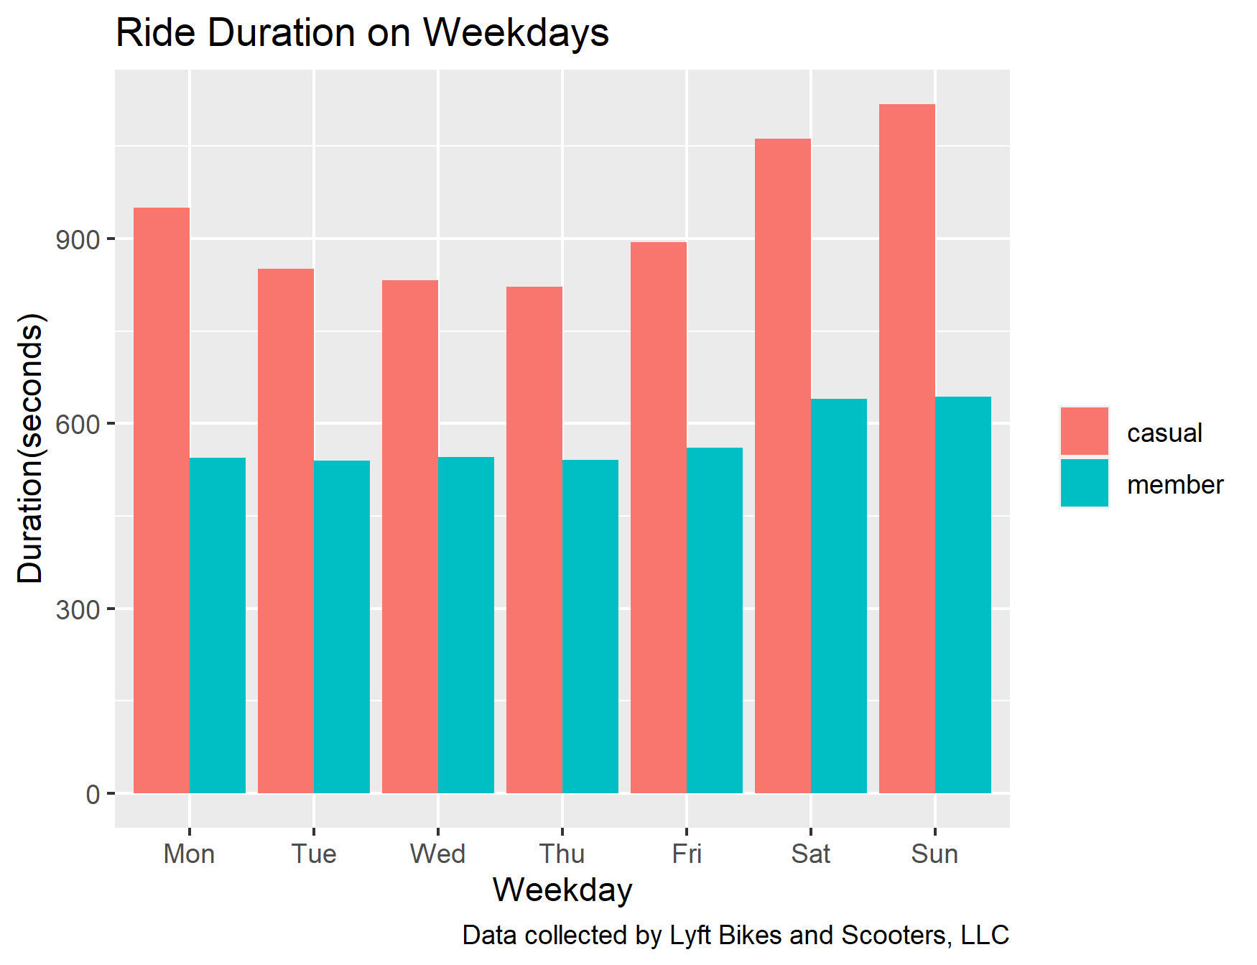
Ride Duration
Conclusions:
Casual riders generally take longer rides than members.
Members are more likely to use Cyclistic bikes as transportation.
Disclaimer: Cyclistic Bikeshare is a fictitious company, but this is real data that was collected and analysed.

Slide 4
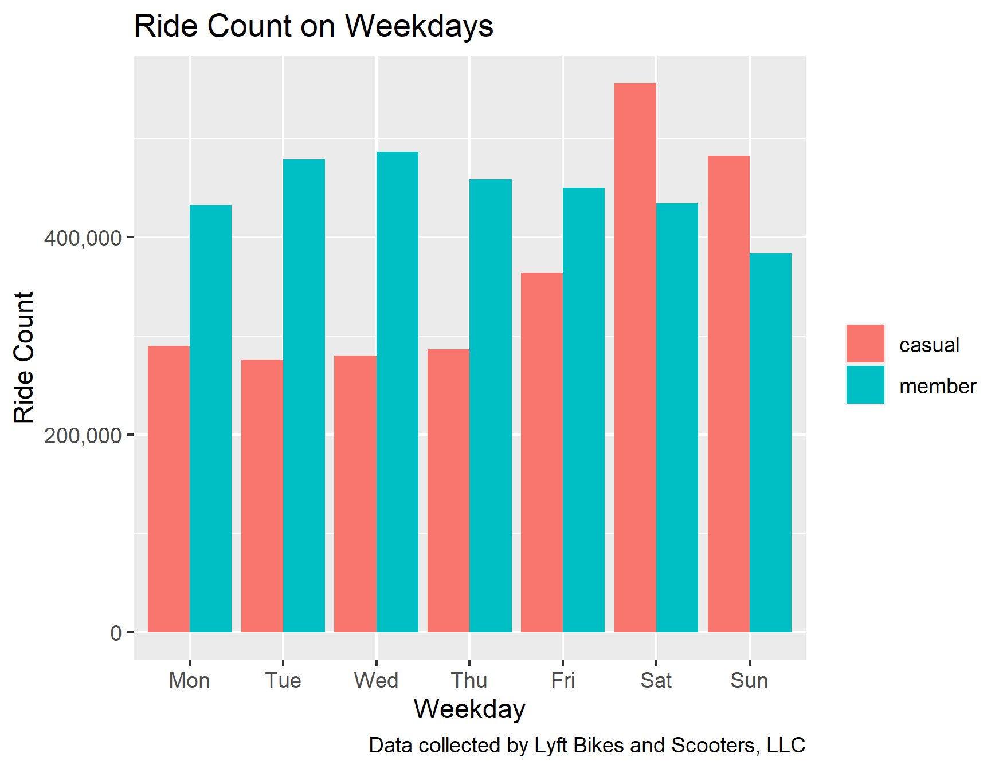
Ride Count
Conclusions:
Casual riders ride more than members on weekends.
Members likely ride more on their commute.
Disclaimer: Cyclistic Bikeshare is a fictitious company, but this is real data that was collected and analysed.

Slide 5
Suggested Course of Action
Market membership as a cheap, clean, and green method of transportation.
Market membership through the lens of commuting to work
Target long ride demographic for membership
Disclaimer: Cyclistic Bikeshare is a fictitious company, but this is real data that was collected and analysed.

